Slide 1
States of matter
The gaseous state: ideal and real gases and pV = nRT
Bonding and structure

Slide 2
Introduction
The three different states of matter are: solids, liquids and gases.
Particles in solids vibrate at their fixed position and are tightly packed in a lattice structure. They are incompressible.
Particles in liquids are close together but not tightly packed. The particles can slide over each other and hence, liquids flow. Liquids are also incompressible.
Particles in gases are spaced far apart and arranged randomly. Gases are compressible.

Slide 3
Gaseous state
An ideal gas is based on the assumptions that:
The volume of particles is negligible compared to the volume of the container.
No change in kinetic energy due to particle collisions as these collisions are elastic.
There is no force of attraction between particles and the walls of the container.
Particles are in continuous random movement colliding with other particles and the walls of the container.

Slide 4
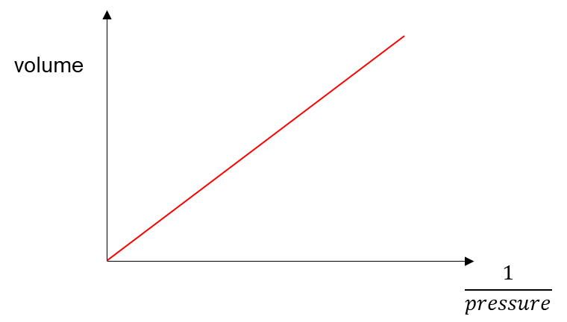

Gaseous state
In reality, all gases do not fit into this assumptions completely. Only noble gases with small atoms such as helium and neon fit into this description because of its small intermolecular forces.
Implementing these assumptions, Boyle discovered that at a constant temperature, the pressure due to collisions is inversely proportional to the volume of the gas.
$$P∝\frac{1}{V} (at constant temperature)$$
Therefore, $PV=constant$
Relationship between volume and pressure of gases (at constant temperature)

Slide 5
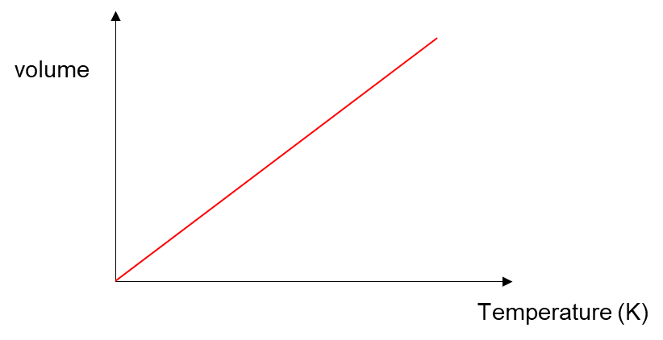

Gaseous state
Charles implemented these assumptions and found out that the volume occupied by gas is directly proportional to temperature at constant pressure.
$$V∝T (at constant pressure)$$
Relationship between volume and temperature (at constant pressure)

Slide 6

Gaseous state
Using Charles’ and Boyle’s law, an ideal gas equation was developed
$$PV=nRT$$
where n is the number of moles and R is the universal molar constant.
Units of the terms used in an ideal gas equation are given in the table below:
P | V | n | T | R
Pascals (Pa) | m³ | mol | K | 8.314 J/mol K
atm | dm³ | mol | K | 0.08206 atm dm³/ mol K

Slide 7
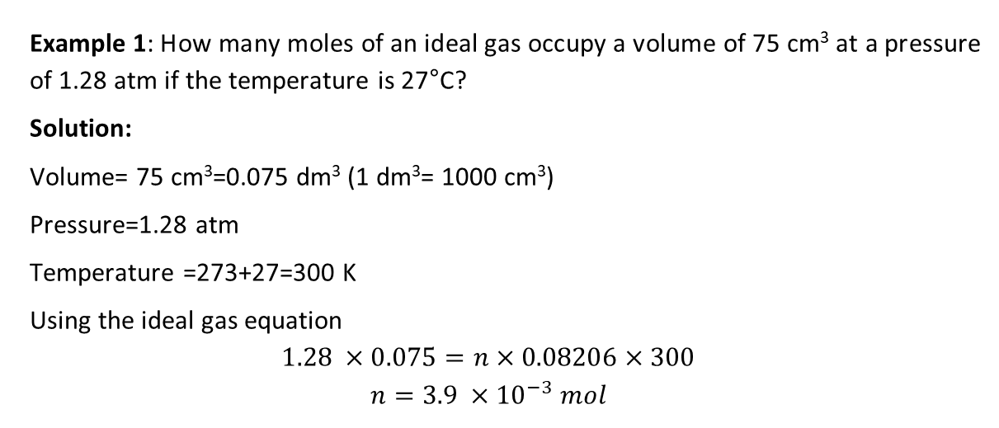
Gaseous state
Example 1: How many moles of an ideal gas occupy a volume of 75 cm³ at a pressure of 1.28 atm if the temperature is 27°C?
Solution:
Volume= 75 cm³=0.075 dm³ (1 dm³= 1000 cm³)
Pressure=1.28 atm
Temperature =273+27=300 K
Using the ideal gas equation
$$1.28 ×0.075=n×0.08206×300$$
$$n=3.9 ×{10}^{−3} mol$$

Slide 8
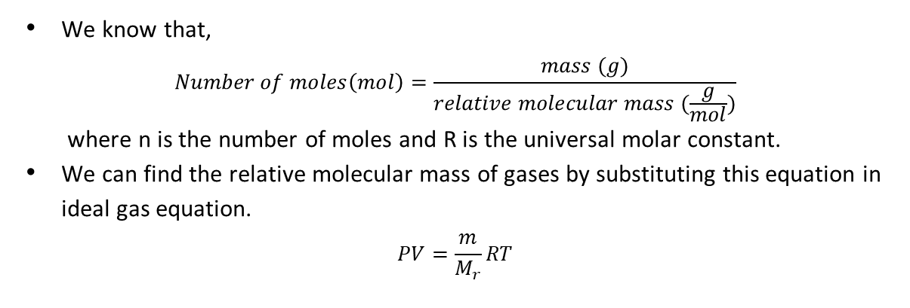
Gaseous state
We know that,
$$Number of moles\left(mol\right)=\frac{mass (g)}{relative molecular mass (\frac{g}{mol})}$$
where n is the number of moles and R is the universal molar constant.
We can find the relative molecular mass of gases by substituting this equation in ideal gas equation.
$$PV=\frac{m}{M_{r}}RT$$

Slide 9
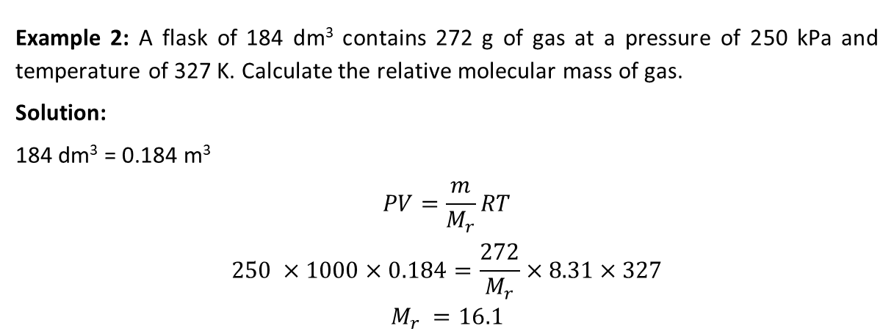
Gaseous state
Example 2: A flask of 184 dm³ contains 272 g of gas at a pressure of 250 kPa and temperature of 327 K. Calculate the relative molecular mass of gas.
Solution:
184 dm³ = 0.184 m³
$$PV=\frac{m}{M_{r}}RT$$
$$250 ×1000×0.184=\frac{272}{M_{r}}×8.31×327$$
$$M_{r} =16.1$$

Slide 10
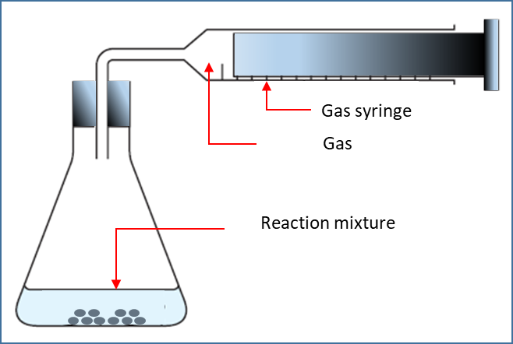
Gaseous state
A simple gas syringe that measures the volume of gas released in a reaction is shown in the figure.
Molecular mass of volatile liquids can also be found by placing them in syringe oven wherein the liquid is vaporised and its volume is calculated.
Kinetic theory of gases does not consider forces of attraction between molecules and volume of molecules. Therefore real gases do not obey ideal gas laws at high pressure and very low temperatures.

Slide 11
Activities
study.com/academy/lesson/using-the-ideal-gas-law-to-find-the-molar-mass-of-a-gas.html
ch301.cm.utexas.edu/simulations/js/idealgaslaw/
www.docbrown.info/page03/3_52gaslaws2.htm
www.youtube.com/watch?v=IoCWUYMagEg
www.youtube.com/watch?v=IoCWUYMagEg
edu.rsc.org/resources/the-determination-of-relative-atomic-mass/401.article

Slide 12
Liquid state
Particles in liquids are close together but not tightly packed. The particles can slide over each other and hence, liquids flow. Liquids are also incompressible.
The process that changes the states of matter are:
Melting
Freezing
Vaporisation
Condensation

Slide 13
Melting & Freezing
Melting:
When a solid is heated, the particles gain kinetic energy and vibrate more vigorously.
As a result, the force of attraction between the particles weaken.
The temperature at which the solid changes to liquid is called melting point.
Freezing:
When a liquid is cooled, the particles lose kinetic energy and the force of attraction between the particles strengthens.
The temperature at which the liquid changes to solid is called freezing point.

Slide 14
Vapourisation
When a liquid is heated, the particles gain kinetic energy and vibrate more vigorously.
As a result, the force of attraction between the particles weakens.
Particles at the surface of liquid escape in the form of vapor. This is called as evaporation and occurs at a temperature lower than boiling point.
When the temperature is further increased to boiling point, the liquid boils and the force of attraction between particles throughout the liquid weakens.
Now, the particles spread out randomly changing to gaseous state.
The change from liquid state to gaseous state is called as vapourisation.

Slide 15
Condensation
When a vapour is cooled, the particles lose kinetic energy and the force of attraction between the particles strengthens.
At a certain temperature, the vapour changes to liquid state. This process is called as condensation.

Slide 16
Vapour pressure
When a liquid is heated in a closed container, the particles escape from the surface in the form of vapour initially.
When more and more particles in vapour state come together, the particles with lower kinetic energy come together to condense and change to liquid state.
At equilibrium, the water molecules change to vapour at the same rate at which it returns to liquid state.
water molecules (liquid state) ⇋ water molecules (vapour state)

Slide 17
Vapour pressure
The vapour particles hit the walls of the container and the pressure exerted by vapour at this equilibrium is called vapour pressure.
Vapour pressure increases with temperature because with temperature, the kinetic energy of particles increases, and they hit the walls of the container more vigorously.
An alternate definition for boiling point is stated with respect to vapour pressure. The temperature at which the vapour pressure is equal to atmospheric pressure is called boiling point.

Slide 18
Solid state
Particles in solids vibrate at their fixed position and are tightly packed in a lattice structure. Different types of lattice structures are given below:
Ionic lattice
Metallic lattice
Simple molecular lattices
Giant molecular structures

Slide 19
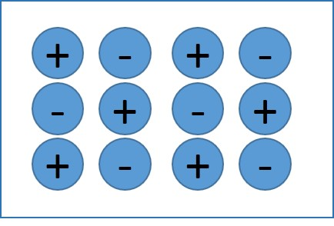
Ionic lattice
Three dimensional structures of ionic compounds that exist in the form of alternate positive and negative ions is called ionic lattice.
Giant ionic lattice

Slide 20
Ionic lattice: properties
Hard: Due to the strong electrostatic force of attraction between oppositely charged ions, it is hard to break these forces by scratching the surface.
Brittle: Force applied along the layers displaces the ions. Due to this displacement, like charges come near to each other and the force of repulsion between like charges disrupts the bonding.
High melting and boiling points: The melting and boiling points increases with charge density. The melting point of MgO is higher than that of NaCl. The ionic bond of MgO is stronger than NaCl because Mg²⁺ and O²⁻ has greater charge when compared to Na⁺ and Cl⁻.
Soluble in water
Conduct electricity in molten state or in solution

Slide 21
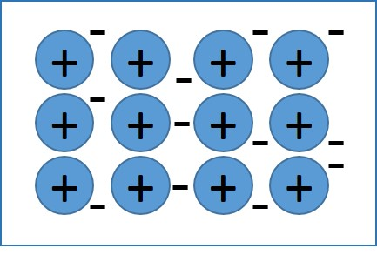
Metallic lattice
Metals are good conductors of electricity and non-metals are poor conductors of electricity.
Metals are bonded in giant lattice structure held together by strong electrostatic force of attraction between positive ions and free electrons.
Free electrons are the valence electrons of the atoms.
Metallic lattice

Slide 22
Metallic lattice: strength of metallic bonding
The strength of metallic bonding depends on number of factors such as:
Number of protons: The more the protons, stronger the force of attraction and stronger is the bond.
Number of free electrons: The more the number of free electrons, the stronger the bond.
Size of ion: The smaller the ion, the stronger the bond.

Slide 23
Metallic lattice: properties
When a force is applied, the layers slide over each other. As they slide, they form new bonds at a different lattice position.
Some of the properties of metals are:
Hard: Due to strong electrostatic force of attraction between metal ions and free electrons
Malleable: Metals can be hammered to different shapes
Ductile: Metals can be drawn in the form of wires
High tensile strength
Good conductors of electricity

Slide 24
Metallic lattice: Alloys
Alloy is a mixture of two or more metals or a metal and a non-metal.
For example: Brass is an alloy of 70 % of copper and 30 % of zinc.
Due to the presence of zinc ions, that are larger than copper ions, the layers of brass do not slide over each other as easily as in the case of copper.
The lattice structure of brass is not easily disturbed. Thus, brass is stronger than copper but malleable.
Bronze is an alloy of copper and tin.
Aluminum has excellent thermal and electrical conductivity but light weight. To enhance its strength, it is mixed with other metals such as copper, manganese, etc. to form alloys.

Slide 25
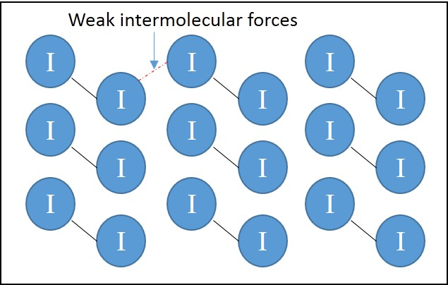
Simple molecular lattices
The structure of crystals of iodine where the iodine molecules are held by strong instantaneous dipole forces in shown in the diagram.
In solid argon, the molecules are held together by weak instantaneous dipole forces.
In solid hydrogen chloride, strong dipole-dipole forces exist.
Simple molecular lattice

Slide 26
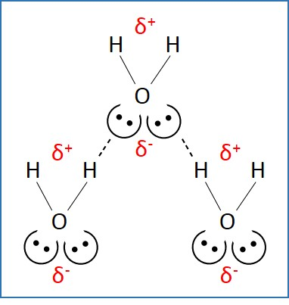
Simple molecular lattices
Ice also forms crystalline lattice structure.
The properties of ice and water are anomalous due to the presence of hydrogen bonding.
For example: ice is less dense than water and they have relatively high melting points and boiling points compared to other hydrides of group 16.
Strong hydrogen bonding exists in Sucrose (C₁₂H₂₂O₁₁).
Based on the strength of the intermolecular forces, the increasing order of melting points is argon < hydrogen chloride < water < iodine < sucrose.
Water molecule

Slide 27
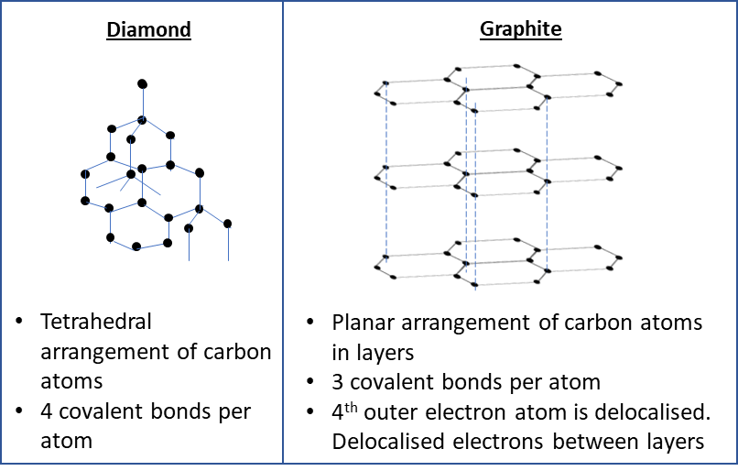
Giant molecular structures
Three dimensional structures of covalent bonds is called giant molecular structures or giant covalent structures.
Carbon has four valence electrons. It is available in the form of diamond and graphite.
Diamond is arranged in tetrahedral structure with four covalent bonds per atom.
Graphite has planar arrangement of carbon atoms in layer. It has 3 covalent bonds per atom in each layer.

Slide 28
Giant molecular structures: Properties
Diamond:
Hardness: Difficult to break the three-dimensional network
High melting and boiling points: Due to the presence of strong covalent bonds.
Poor conductor of electricity: No free electrons.
Graphite:
Softness: The layers of graphite can slide over each other.
High melting and boiling points: Due to the presence of strong covalent bonds.
Conducts electricity.

Slide 29
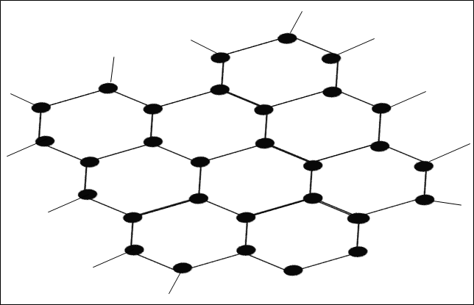
Giant molecular structures: Graphene
A single layer of graphite that is isolated is called as graphene. The structure of graphene is not rigid and may be distorted.
Properties:
Strong
Highly reactive than any other forms of carbon
Good conductor of electricity and heat
It is used in electrical circuits and in solar cells, transistors and touchscreens.

Slide 30
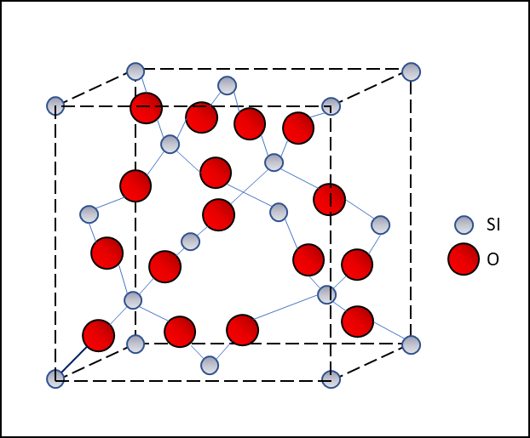
Giant molecular structures
Silicon (IV) oxide also has a structure similar to that of diamond.
It is found in mineral quartz.
Its properties are similar to that of diamond.
Structure of Silicon (IV) oxide

Slide 31
Giant molecular structures: Buckminsterfullerene
Allotropes of carbon arranged in the form of hollow spheres or tubes are called fullerenes.
It contains rings of carbon arranged in the form of hexagons with some rings in the form of pentagons.
Buckminsterfullerene (C₆₀) is the first fullerene discovered by scientists, which exists in the shape of football.
The carbons atoms are arranged in the form of 20 hexagons and 12 pentagons.
Although some electrons, in C₆₀ are delocalised as in graphite, the extent of delocalisation is lesser in C₆₀.

Slide 32
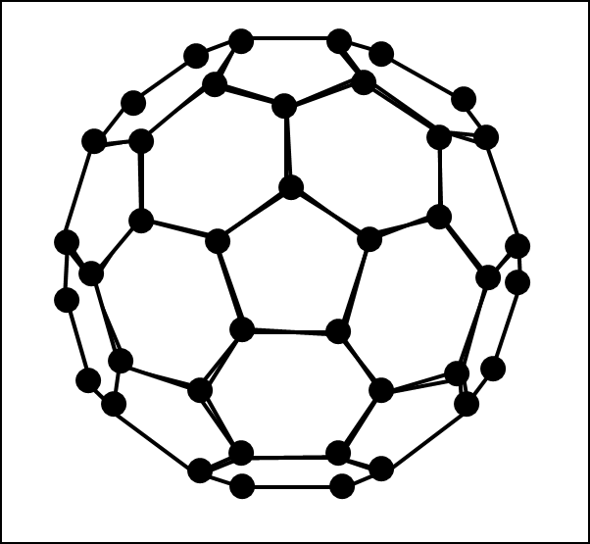
Giant molecular structures
Properties:
Low sublimation point: because of weak van der waals’ forces between each C60 molecule.
Soft: weak intermolecular forces
Poor conductor of electricity: no free electrons
Soluble in solvents such as carbon disulphide and methylbenzene
Reactive compared to graphite and diamond: high electron density in certain parts of molecules allows it to react with hydrogen, fluorine, chlorine, etc.
Fullerenes are used in medical purposes. Molecules of drugs are carried by the cage of C₆₀ to specific organs.
Shape of buckminsterfullerene (C₆₀)

Slide 33
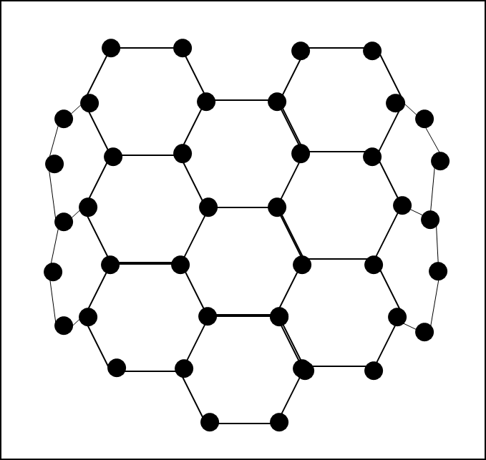
Giant molecular structures
Individual particles in fullerenes may have one of their dimension in size of 0.1 nm to 100 nm. These particles are called as nanoparticles.
The carbon atoms are arranged in hexagonal shape. The length of the cylinder is million times greater than its diameter.
Nanotubes are structures wherein single layer of graphite is bent in the form of a cylinder. Its properties are:
High electrical conductivity
High tensile strength
High melting points
Nanotubes are used as electrical conductors in tiny electrical circuits. Also, used in treatment of cancer. Nanotubes are also combined with clothing to improve strength.
Part of structure of carbon nanotube

